Slide 1

Z
ZeroTo1 Academy
From Code to
Congress
The Elite CAC Accelerator
April–December 2026 Residency
Only 20 Seats
Grades 6–12
$197/mo

Slide 2
The Competition
America's Premier Youth Coding Competition
13,830
4,650
394
Student Impact
Students 2025
Apps Submitted
Congress Districts
Continue Coding
88%
STEM Career Interest
89%
What Winners Receive
AI Integration
56%
U.S. Capitol Display
Winning apps featured in the Capitol Building
#HouseOfCode Invitation
Showcase on Capitol Hill to Congress & tech leaders
$500 Collegewise Credit
Expert college admissions counseling
90% of Congress
Participates in this bipartisan initiative—the highest level of Congressional engagement in youth STEM education.
85,000+ students have participated since 2015

Slide 3

The Challenge
Code Without Context
Most students have the "Code," but they lack the "Context"
01
The Struggle
Students spend months coding apps that nobody needs. The Congressional App Challenge isn't just a coding competition—it's a policy and impact competition.
Technical skills without real-world problem identification
02
The Risk
Technical disqualifications due to complex House.gov submission rules. The 1-3 minute demonstration video requirements are exacting and unforgiving.
Brilliant apps rejected due to compliance failures
03
The Result
Brilliant kids missing out on national recognition because they didn't have a "Product Team" to guide them through the entire journey.
Potential unrealized due to lack of mentorship

Slide 4
The Solution
Meet Your AI Product Team
Not tutorials. A Digital Board of Directors.
Multi-Agent Classroom
24/7 Expert Guidance
Our proprietary environment puts a team of "experts" in the room with your student around the clock. This isn't passive learning—it's active mentorship powered by AI agents trained on winning strategies.
Policy Advisor
Lead Architect
Trained on 5 years of winning data. Vets your student's idea against the "Congressional Impact" rubric before they write a single line of code.
Python & No-Code specialist who debugs in real-time and teaches "Clean Code" principles used by Silicon Valley professionals.
Winning DNA Analysis
Real-Time Debugging
House Liaison
Media Director
Your compliance officer. Knows every House.gov rule, ensuring the 1-3 minute demonstration video and documentation are perfect.
A storytelling expert who helps script, storyboard, and edit the final pitch video that judges actually want to watch.
Submission Compliance
Pitch Perfect Videos

Slide 5

The ZeroTo1 Expert Agents
Your 24/7 Digital Board
Policy Advisor
Lead Architect
Strategic Intelligence
Technical Excellence
Analyzes 5 years of winning projects to identify patterns
Real-time debugging and code optimization
Validates ideas against Congressional Impact rubric
Teaches Clean Code principles from Silicon Valley
Ensures real-world problem alignment before coding begins
Python & No-Code specialization
Impact: Prevents wasted months on misaligned projects
Impact: Industry-standard code quality from day one
House Liaison
Media Director
Compliance Guardian
Storytelling Mastery
Masters every House.gov submission rule
Scripts compelling pitch narratives
Validates 1-3 minute video requirements
Storyboards demonstration videos
Ensures documentation completeness
Guides editing for maximum impact
Impact: Zero technical disqualifications
Impact: Videos that captivate judges

Slide 6
The Curriculum
The April–December Journey
9 Months to Mastery. We Don't Rush Greatness.
01
Discovery
02
Logic & Architecture
03
The Build Sprint
04
Submission & Launch
April – May
June – July
August – September
October – December
Community problem-solving and competitive analysis using our "Winning DNA" database.
Wireframing, database design, and user-flow mapping. Think before you build.
Hands-on development in the ZeroTo1 Interactive Lab with AI agent guidance.
Final debugging, video production, and official House.gov submission.
Journey Milestones
Month 1-2: Problem Validation
Identify community needs, analyze winning patterns, validate impact potential
Month 3-4: Technical Design
Perfectly Aligned Timeline
Create wireframes, design database schema, map user flows
Month 5-6: Development
Our 9-month curriculum aligns with the Congressional App Challenge's official June–November competition window.
Build with real-time AI debugging, code reviews, feature implementation
Month 7-9: Launch Excellence
Official CAC Submission: October–November
Polish, create pitch video, ensure compliance, submit to House.gov

Slide 7

Phases 1–2
Discovery & Architecture
April – July: Foundation Before Code
01
Discovery
02
Logic & Architecture
April – May
June – July
Community Problem-Solving
Wireframing & UX Design
Students learn to identify real problems in their communities that technology can solve. Not hypothetical scenarios—actual needs.
Create detailed wireframes mapping every screen, interaction, and user journey. Design for usability and impact.
Winning DNA Analysis
Database Schema Design
Deep dive into 5 years of winning projects. Understand what judges value: impact, innovation, technical complexity, and presentation quality.
Architect data structures that support app functionality. Learn relational and NoSQL database principles.
Idea Validation
User-Flow Mapping
Policy Advisor vets concepts against the Congressional Impact rubric before any code is written.
Map complete user flows from first interaction to goal completion. Identify edge cases and optimize experiences.
Outcome: Validated, impactful project concept
Outcome: Complete technical blueprint

Slide 8

Phases 3–4
Build Sprint & Launch
August – December: Execute with Excellence
03
The Build Sprint
04
Submission & Launch
August – September
October – December
ZeroTo1 Interactive Lab
Final Polish & Debugging
Hands-on development environment with AI agents providing real-time guidance, debugging, and code reviews.
Comprehensive testing, edge case handling, performance optimization. Ensure the app is submission-ready.
Continuous Debugging
Pitch Video Production
Lead Architect identifies issues instantly, teaches debugging strategies, and ensures code quality throughout development.
Media Director guides scripting, storyboarding, and editing of the 1-3 minute demonstration video—the critical judging component.
Feature Implementation
House.gov Submission
Build core functionality following Clean Code principles. Learn industry best practices from Silicon Valley standards.
House Liaison ensures perfect compliance with all submission requirements. Documentation, video, and metadata—all validated.
Outcome: Fully functional, polished application
Outcome: Competition-ready submission

Slide 9
Competitive Intelligence
The Winning DNA Database
5 Years of Insights. Your Competitive Edge.
5+
394
100%
Years of Data
Districts Covered
Pattern Recognition
Analyzed winning projects from 2019–2024
Nationwide winning project analysis
What judges consistently value
What the Data Reveals
Success Patterns
Healthcare & Wellness
28%
Clear Problem Statement
Winners articulate specific community needs with data
Education & Learning
24%
Technical Sophistication
Environment & Sustainability
19%
Appropriate complexity without over-engineering
Accessibility & Inclusion
16%
User-Centered Design
Evidence of user testing and iteration
Community & Civic
13%
Compelling Demonstration
Videos that tell a story, not just show features
How Students Use It: Validate ideas against winning patterns before investing months in development

Slide 10
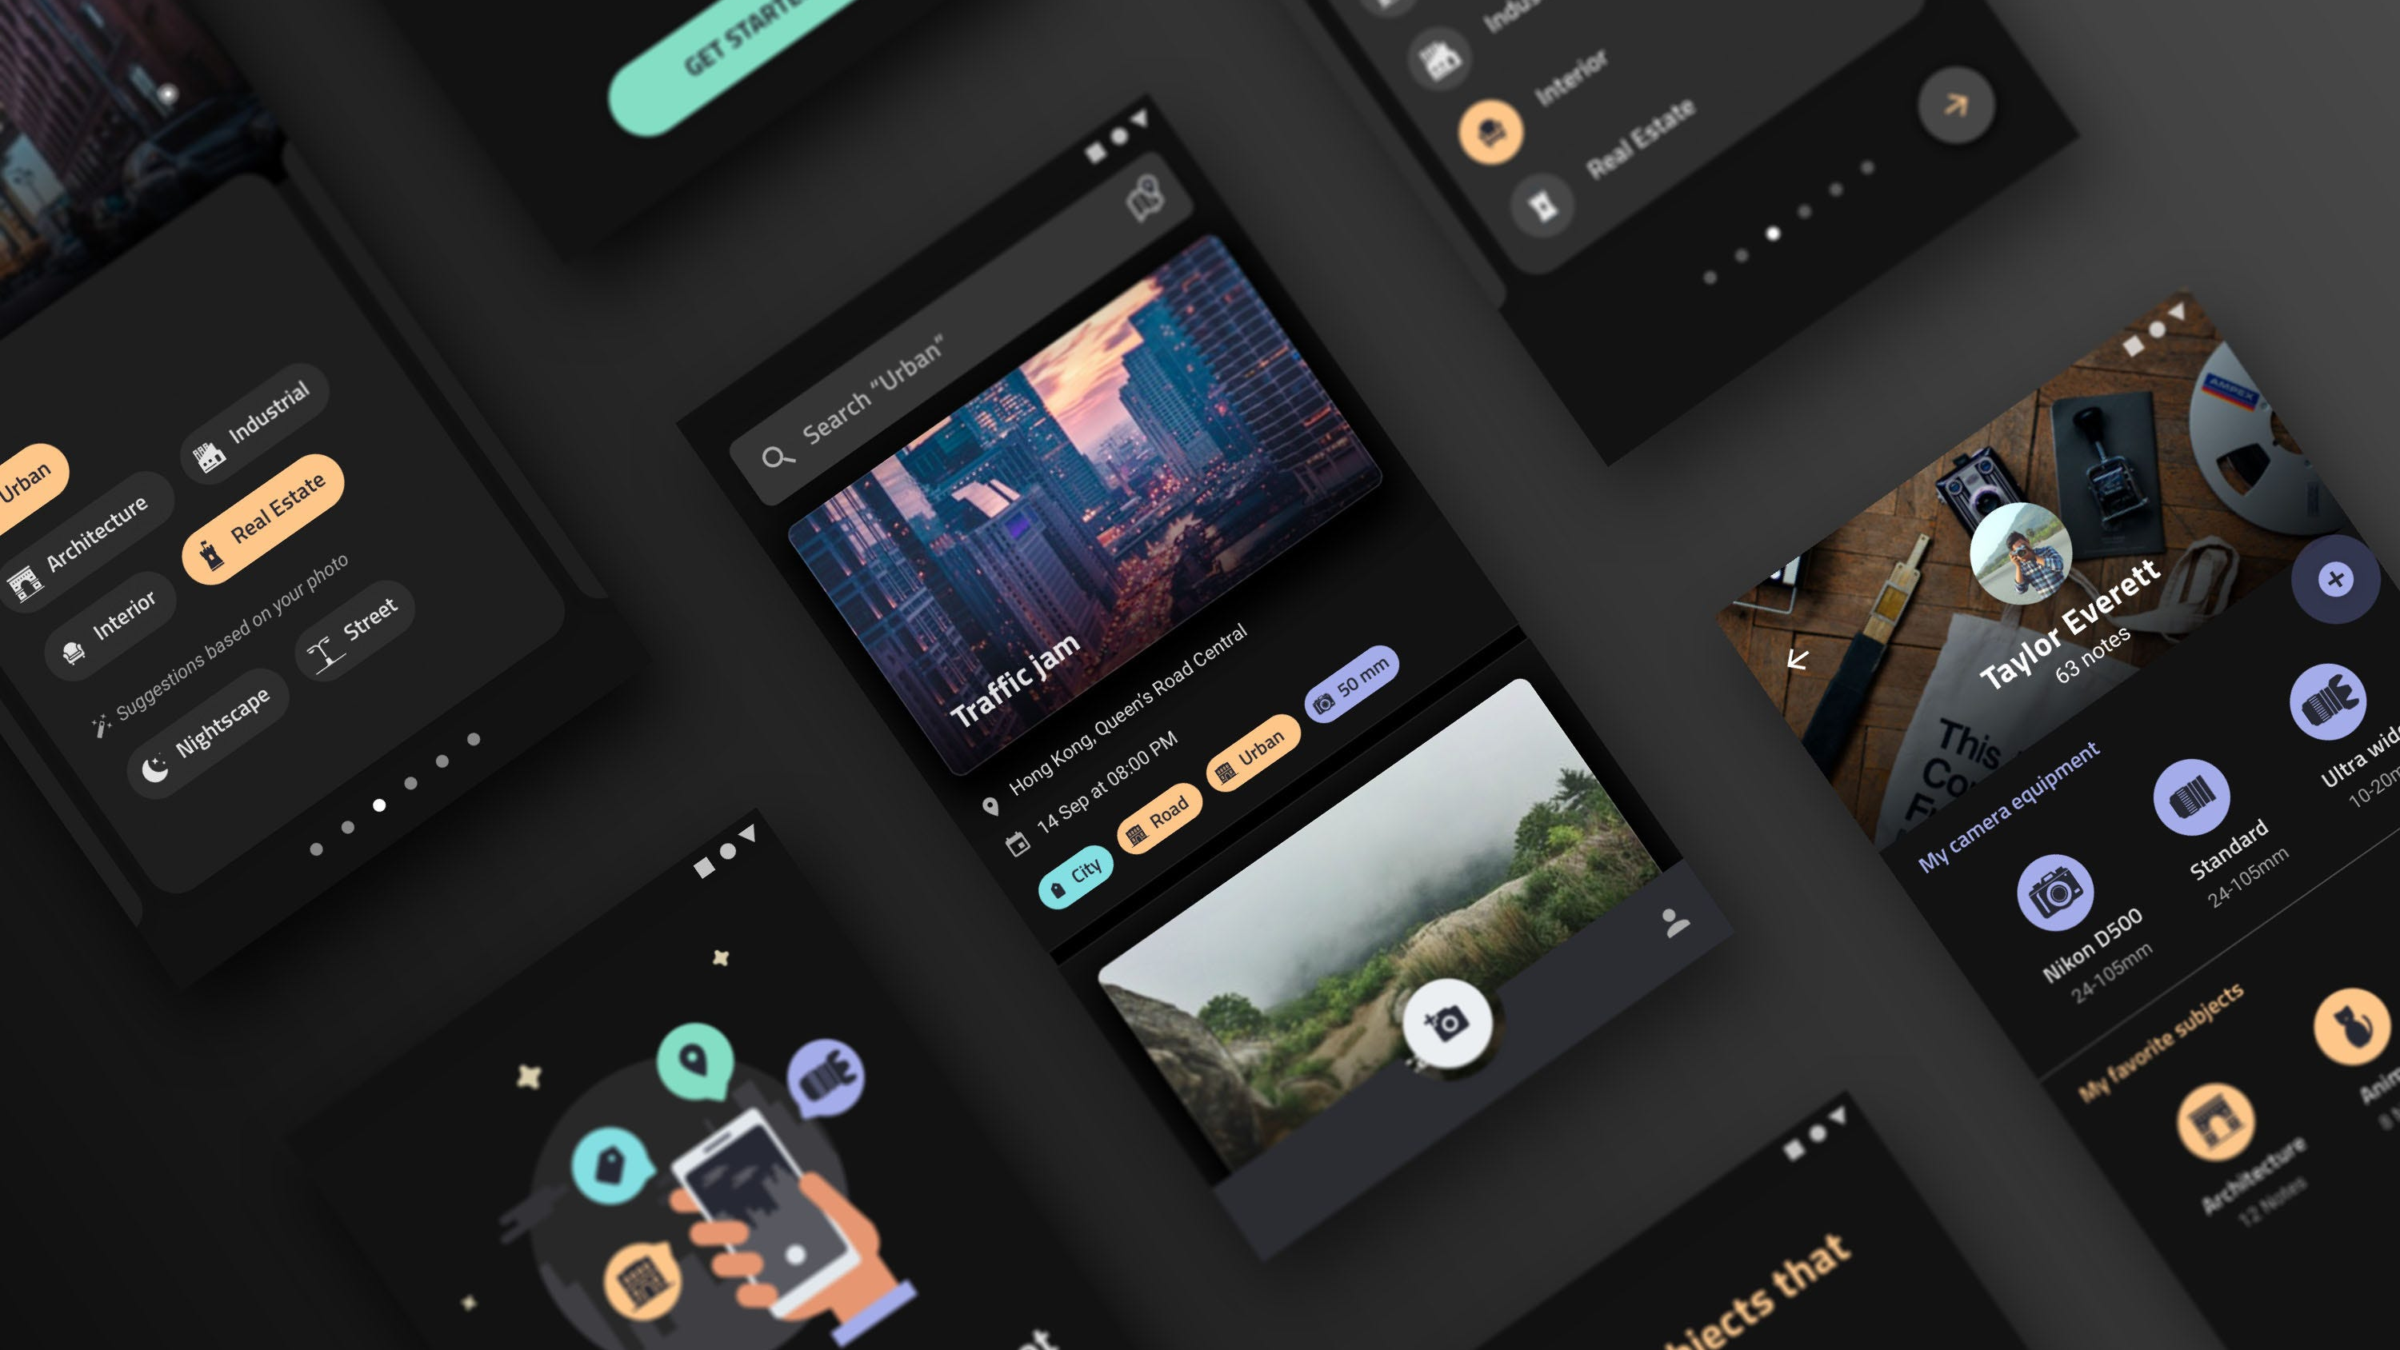
The 2026 Season Pass
What's Included
Everything Your Student Needs to Win
Unlimited AI Access
PBL Dashboard
24/7 access to the ZeroTo1 Multi-Agent Classroom with all four expert agents: Policy Advisor, Lead Architect, House Liaison, and Media Director.
Project-Based Learning dashboard tracks every stage of development: Discovery → Architecture → Build → Launch.
Winner Benefits
Winning DNA Database
Full access to 5 years of analyzed winning projects. Understand patterns, validate ideas, and learn from the best.
$500 Collegewise Credit for expert college admissions counseling
U.S. Capitol Display of winning app
#HouseOfCode Invitation to Capitol Hill showcase
Monthly Milestone Reviews
National Recognition by Member of Congress
AI-generated progress reports for parents tracking every stage from "Idea" to "U.S. Capitol."

Slide 11
Investment
The 2026 Season Pass
An Elite Extracurricular Investment
$197
Comparable Investments
Music Tutoring
Sports Training
per month
$200-400/mo
$300-600/mo
Private lessons, 9 months
Elite coaching, 9 months
April – December
9 Months Total
College Counseling
CAC Winner Value
$5,000-15,000
$500+
Full package
Collegewise credit alone
Total Investment
Exclusivity
Limited Availability
$1,773
Only 20 seats available for 2026 Season
For complete 9-month residency
Elite residency —not a mass-market course
Personalized attention with dedicated AI agents

Slide 12

Z
Transform Zero Knowledge
into 1 Winning App
ZeroTo1 Academy
20
$197
9
Seats Available
Per Month
Months
April – December 2026 Residency
Founded by Vasu Ranganathan
Apply for the 2026 Cohort

